Slide 1
Genetic Counselling
Year 11 Human Biology
ATAR
PowerPoint #23

Slide 2
SCSA Syllabus Reference
probable frequencies of genotype and phenotype of offspring can be predicted using Punnett squares and by taking into consideration patterns of inheritance, including the effects of dominance, co-dominance, autosomal or sex-linked alleles, and multiple alleles: Huntington's disease, phenylketonuria (PKU), ABO blood groups, red–green colour blindness/haemophilia show different inheritance patterns
pedigree charts can be constructed for families with a particular genetic disorder and can be used to reveal patterns of inheritance and assist in determining the probability of inheriting the condition in future generations
DNA profiling identifies the unique genetic make-up of individuals and can be used in determining parentage

Slide 3
Lesson Intention
To explore the purpose of genetic counselling

Slide 4
Success Criteria
describe different profiling techniques
discuss ethical and social issues surrounding genetic counselling and genetic profiling

Slide 5
Vocabulary
Genetic counselling: advice regarding the risks of genetic disorders in future children
Electrophoresis: a technique used to reveal DNA profiles in a banded pattern

Slide 6
Awareness
During pregnancy, most women take special care of their health and avoid alcohol, cigarettes and other drugs.
This is done to produce a baby without any defects.

Slide 7
Defects
One partner or both, may have or carry genetic defects that can be passed to the baby.
Genetic counselling is a form of advice given from examining a disorder in the family tree. This gives the family information on the likelihood of inheriting a disease.

Slide 8
Profiling Techniques
Advances in biotechnology have resulted in the development of techniques to identify the genetic make-up of individuals.
This enables people to have a better understanding of the chances of having an affected baby.

Slide 9
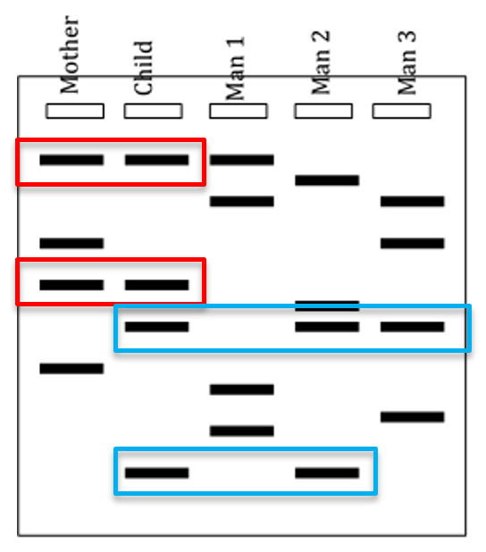
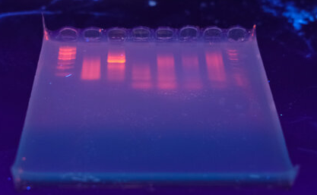
Electrophoresis
DNA pieces are placed on a bed semi-solid gel and an electric current is passed through the gel via electrodes located at each end.
The DNA, which is negatively charged, moves through the gel towards the positive electrode. The smaller DNA pieces move faster than the larger ones, resulting in band of patterns. This is a DNA profile.

Slide 10
DNA profiles
DNA profiles or fingerprints are frequently used in tracing ancestry (tracing/identifying parents and grandparents) and forensic science. They are also helpful for genetic counselling, in the identification of carriers for hereditary diseases such as cystic fibrosis or Huntington’s disease.

Slide 11
Markers
When comparing DNA profiles, scientists use markers.
A marker is a segment of DNA with known characteristics.
The more markers that match, the more likely is that the two individuals are related.

Slide 12
Ethical and Social Issues
Genetic profiling and its applications raise many ethical and social issues.
If genomic data is saved for individuals, who is responsible for holding this data? Who is allowed access? What happens if the data is stolen or misused?
The use of DNA profiling in determining parentage and ancestry requires voluntary DNA samples, but there are cases of samples being obtained without consent.
Government ordered samples (police/court cases) have led to samples being ordered through the law.

Slide 13
Recall Knowledge
How are DNA profiles determined?
Explain why some couples choose to seek genetic counselling.

Slide 14
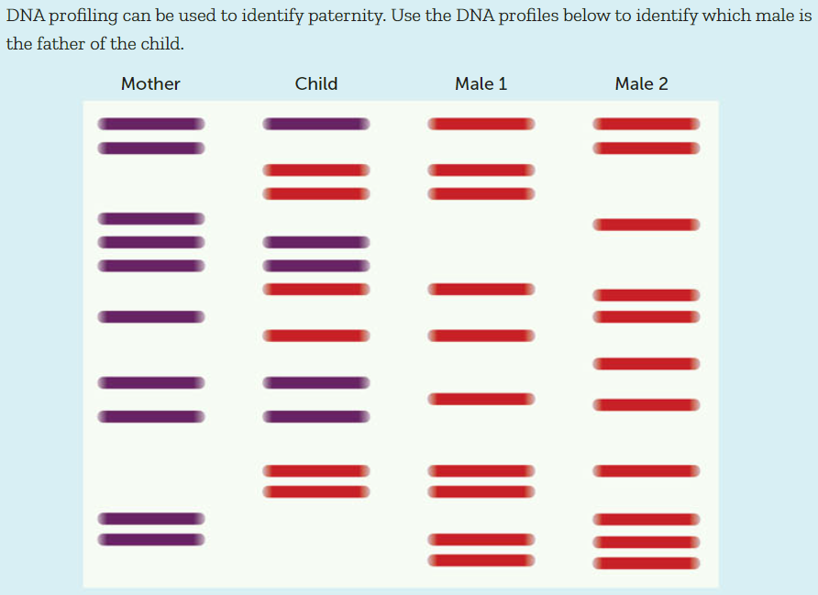
Apply Knowledge

Slide 15
Homework
None ☺

Slide 16
Reading
Pages 406 - 409: Genetic Counselling

